Slide 1
Rest Calls

Slide 2
Consider paths we took:
wordy Java tests
made a printer
made a good printer – not a json: Json test // TODO the json tests
made the inlining – makes it easier to read the whole test better
did multiple conversations
now we can see individual tests, but we can’t see the big picture – so we moved it to the uber test – can delete the other files

Slide 3
Original
@Test public void shouldGetCustomerFromService() { // given accountType = CustomerAccountTypeInfo.builder().account(ACCOUNT_ID).accountType(”PERSONAL").subscription(”MONTHLY").build(); when(responseEntity.getBody()).thenReturn(accountType); // when CustomerAccount result = customerService.retrieveAccount(ACCOUNT_ID); // then CustomerAccount expectedCustomerAccount = new CustomerAccount(ACCOUNT_ID, CustomerPaymentType.MONTHLY, "PERSONAL"); assertThat(result, is(expectedCustomerAccount)); verify(restTemplate, times(1)).exchange(calledUrlCaptor.capture(), eq(HttpMethod.GET), sentHttpEntityCaptor.capture(), any(Class.class)); verifyHeadersAreValid(sentHttpEntityCaptor.getValue().getHeaders()); }

Slide 4
Approval Text
Recorded call to : Conversation Details API
REQUEST
--------------------------------------------------------------------------------
Method : GET
Called Url: /api/v1.2/message/id/500
Headers :
{
"Authorization" : [ "Basic fake" ],
"Cache-Control" : [ "no-cache" ]
}
Body :
null
EXAMPLE RESPONSE
--------------------------------------------------------------------------------
{
"data": [
{
"displayNumber": "500",
"encodedCaseDisposition": 27,
"uuid": "uuid-1",
"createDate": 0,
"responsePortalLink": "/portal/message/500",
"primaryMessage": {
"conversationDisplayId": "500",
"network": "twitter",
"networkInstance": "twitter",
"receiveDate": 0,
"publishDate": 0,
"tags": [
],
"private": true
},
"messages": [
{
"conversationDisplayId": "500",
"network": "twitter",
"networkInstance": "twitter",
"receiveDate": 0,
"publishDate": 0,
"tags": [
],
"private": true
}
],
"tags": [
{
"creator": {
"type": "BOT"
},
"tagId": "34",
"uuid": "uuid2"
}
],
"priority": 4,
"lswPermalink": "/console/bot/500",
"totalResponses": 2,
"hasResponse": false,
"status": "IN_PROGRESS"
}
]
}

Slide 5
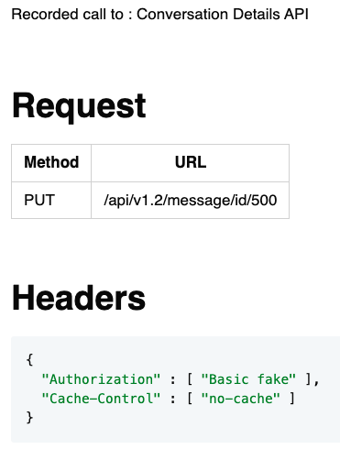
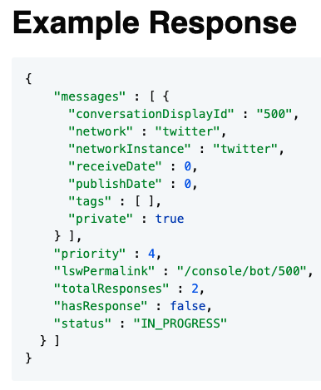
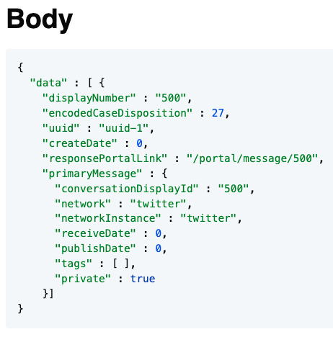
Approval Markdown
2-5 min - Lightning talk?

Slide 6
Conversations

Slide 7
Original
@Test void botIntroducesItselfAndClarifiesIntent() { // given EventNotification message = TestUtils.eventNotification() .userId(UserId.builder().channel(Channel.TEXT).channelId(UUID.randomUUID().toString()).build()) .properties(List.of( new Property("accountId", "1234567"), new Property("code", "411"))) .events(List.of(new MessageEvent(System.currentTimeMillis(), "0", "hi"))).build(); BotNotificationHandler notificationHandler = new BotNotificationHandler(); BotOutboundChannel botOutboundChannel = new BotOutboundChannel(); // when notificationHandler.handle(message); // then BotAction botActions = botOutboundChannel.read(message.getConversationId()); assertThat(botActions.getCommands()) .containsExactly( new SendPlainMessageCommand("Hi there! I'm your virtual assistant."), new SendPlainMessageCommand("What would you like to do today?") ); }

Slide 8
Approvals
@Test void botIntroducesItselfAndClarifiesIntent() { String expected = """ [Customer]: hi [ Bot]: Hi there! I'm your virtual assistant. [ Bot]: What would you like to do today? """; verifyConversation(expected, "hi"); }

Slide 9
Better Testing with Approvals
Llewellyn Falco
Lada Kesseler

Slide 10
// Create side (0,0) – (3,4)
// Verify length
Whiteboard
English
Testing Circle
Result
Code
Side (0,0) – (3,4) length = 5
Side s = new Side(0,0,3,4);
Approvals.Verify(s + “ length = “ +s.Length);

Slide 11
The story so far
Lada: lead developer working on the message bot application
Llewellyn: technical coach working with Lada and work on some tests

Slide 12
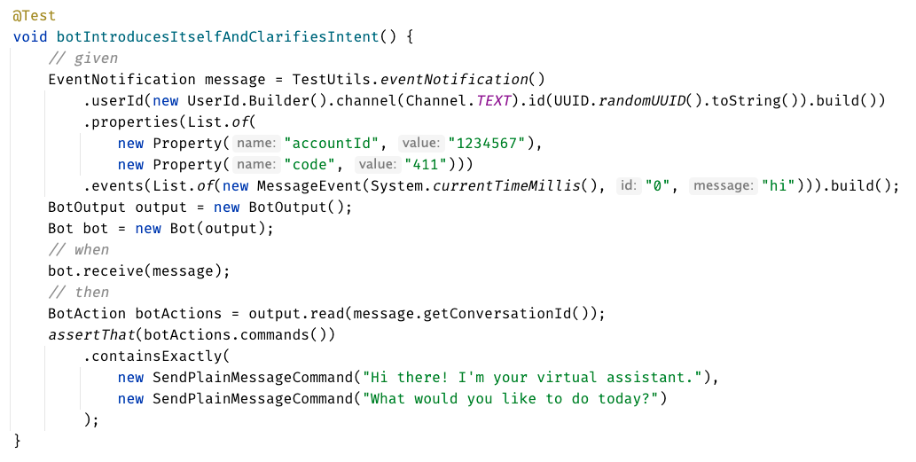
Original Test

Slide 13
?? WHAT IS THIS ??
Chat
[Customer]
hi
[Bot]
Hi there! I'm your virtual assistant.
What would you like to do today?

Slide 14
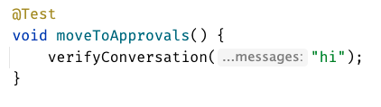
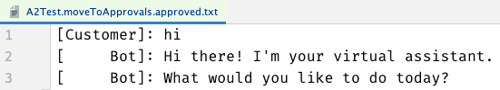
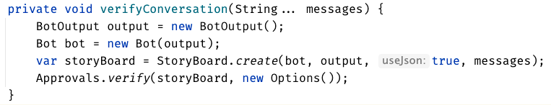

Slide 15
testing circle

Slide 16
Chat
[Customer]
hi
[Bot]
Hi there! I'm your virtual assistant.
What would you like to do today?
Customer says ‘hi’
verify the conversation

Slide 18
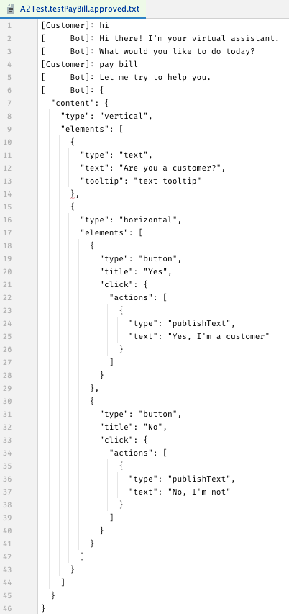
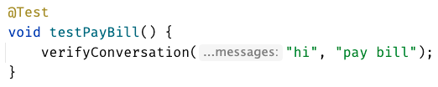

Slide 19

...later that week...

Slide 20
[Customer]: hi [ Bot]: Hi there! I'm your virtual assistant. [ Bot]: What would you like to do today? [Customer]: pay bill [ Bot]: Let me try to help you. [ Bot]: { "content": { "type": "vertical", "elements": [ { "type": "text", "text": "Are you a customer?", "tooltip": "text tooltip" }, { "type": "horizontal", "elements": [ { "type": "button", "title": "Yes", "click": { "actions": [ { "type": "publishText", "text": "Yes, I'm a customer" } ] } }, { "type": "button", "title": "No", "click": { "actions": [ { "type": "publishText", "text": "No, I'm not" } ] } } ] } ] } }

Slide 21
[Customer]: hi [ Bot]: Hi there! I'm your virtual assistant. [ Bot]: What would you like to do today? [Customer]: pay bill [ Bot]: Let me try to help you. [ Bot]: Are you a customer? [ ]: 1) Yes, I'm a customer [ ]: 2) No, I'm not

Slide 22
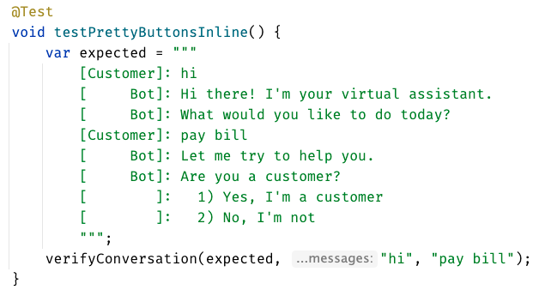
inline - everything in test

Slide 23
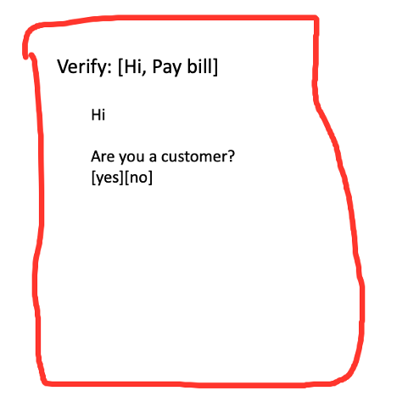
lots of tests – most of them work
different test – in old test format

Slide 24
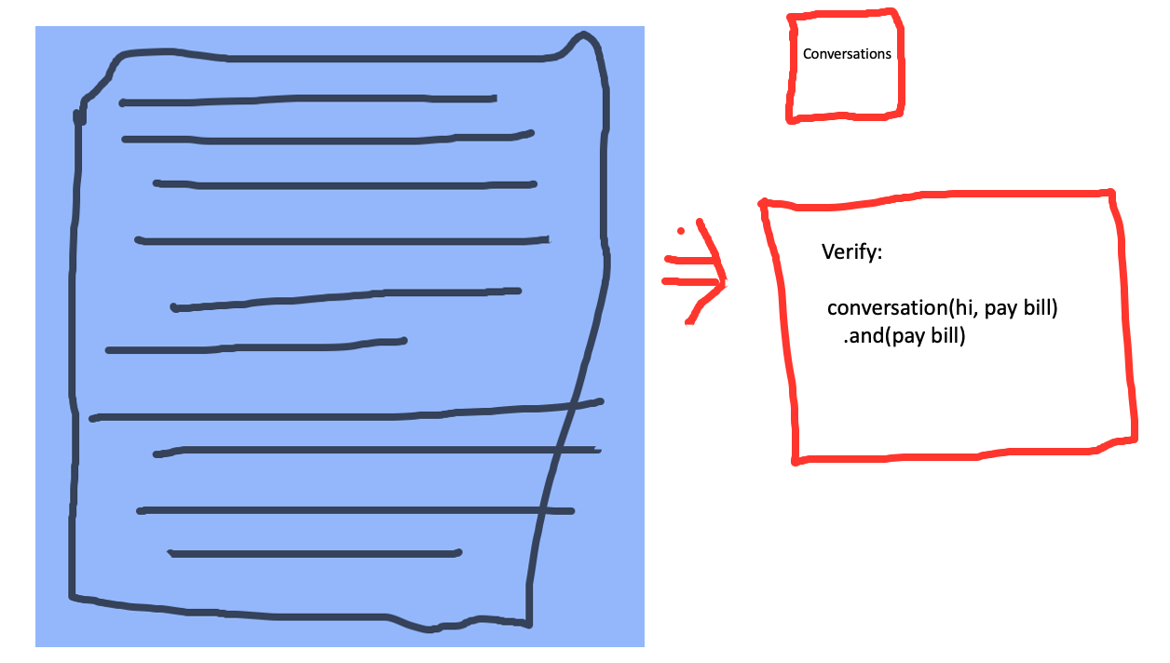

Slide 25
lots of tests – most of them work
different test – in old test format

Slide 26
lots of tests –all of them work
consistency in all of our tests

Slide 27
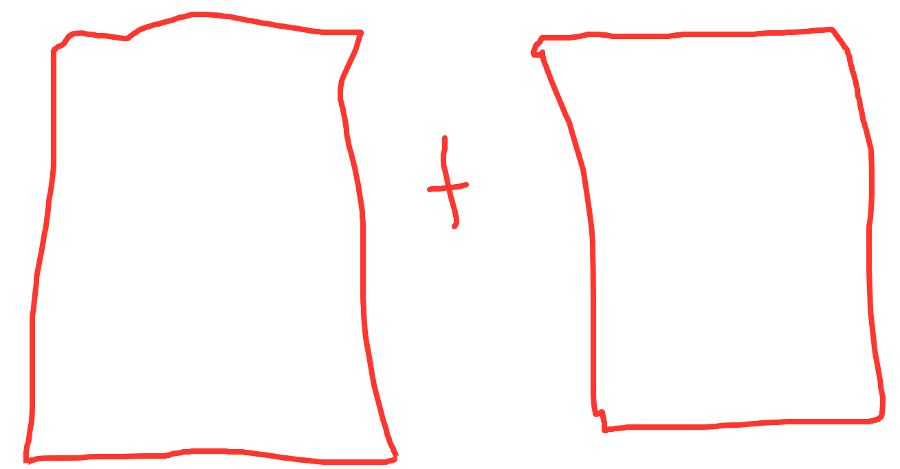
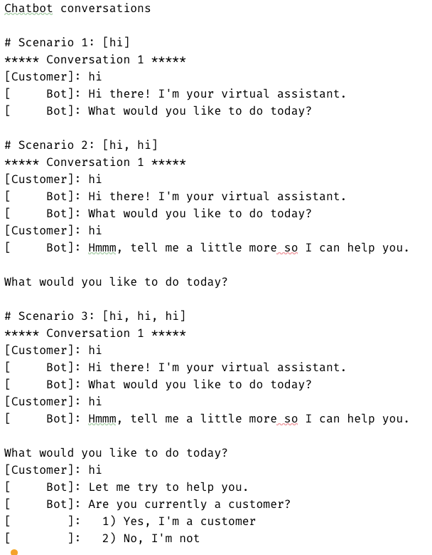
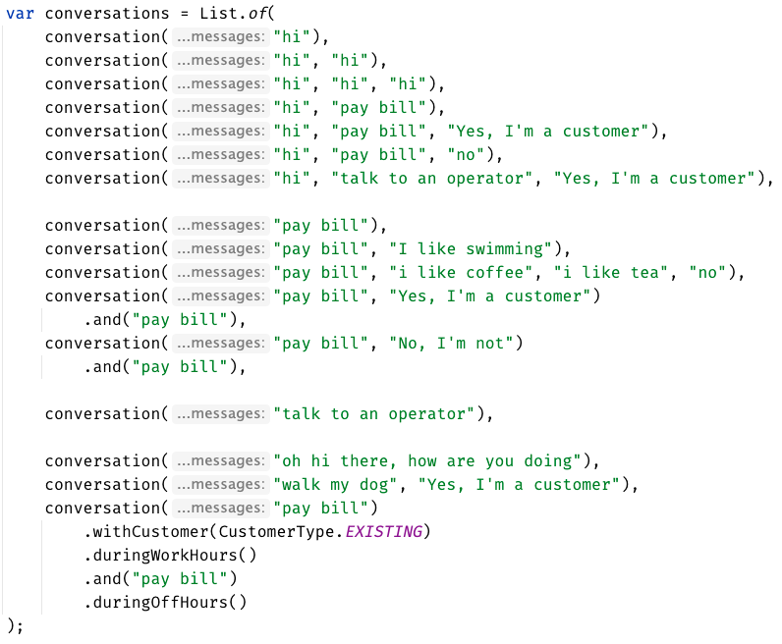
Much easier to see the big picture
Approved
how do they relate to each other? what’s the differences? grouping

Slide 28
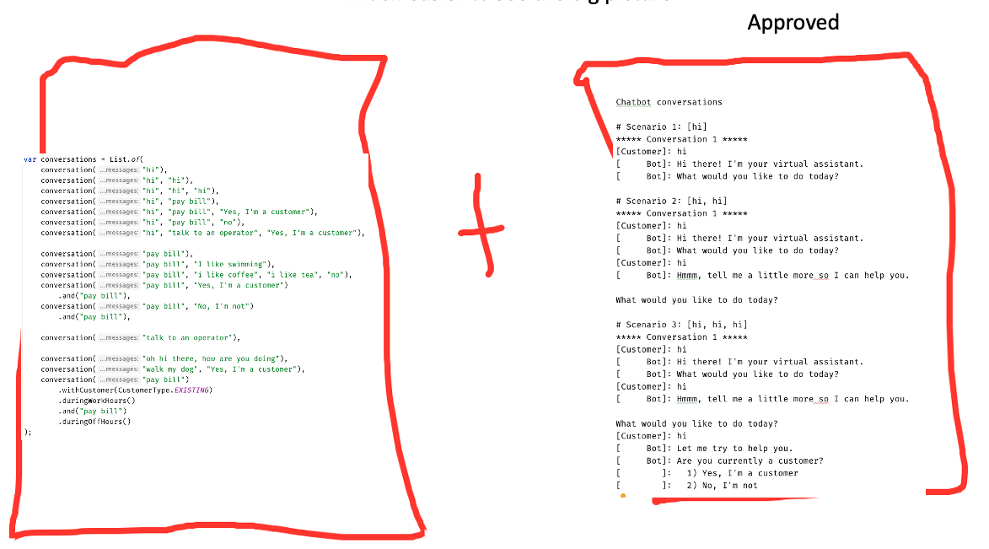
Much easier to see the big picture
we still have this one
in the new format
messy setup – needed config
messy setup

Slide 29
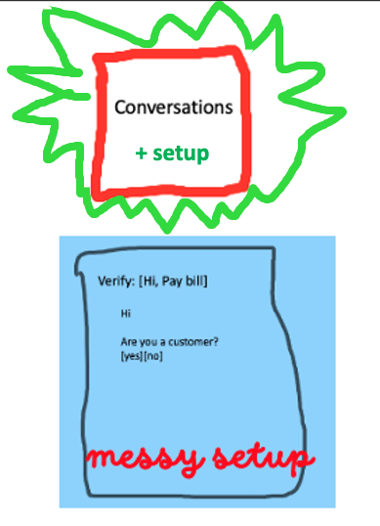

Slide 30
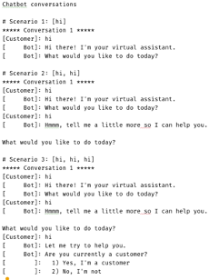
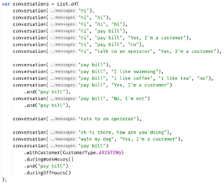
Much easier to see the big picture
Approved
how do they relate to each other? what’s the differences? grouping

Slide 31
can see only
up to here
foggy
as the details disappear,
we get to see the next layer
person

Slide 32
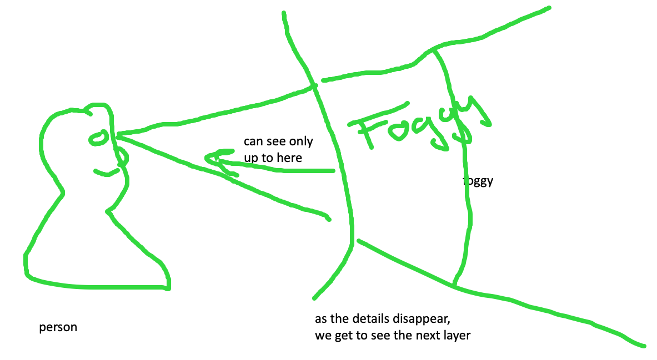
feedback loop – too hard and impossible is the same thing, stop to look

Slide 33
